Slide 1

RESIZEABLE ARRAYS
MUHAMMAD OMER SIDDIQUI 19B-004-SE A
MUHAMMAD ISMAIL MIAN 19B-019-SE A
This Photo by Unknown Author is licensed under CC BY-SA

Slide 2
What are resizable arrays?
In computer science, a dynamic array, growable array, resizable array, dynamic table, mutable array, or array list is a random access, variable-size list data structure that allows elements to be added or removed. It is supplied with standard libraries in many modern mainstream programming languages. Dynamic arrays overcome a limit of static arrays, which have a fixed capacity that needs to be specified at allocation.
A dynamic array is not the same thing as a dynamically allocated array, which is an array whose size is fixed when the array is allocated, although a dynamic array may use such a fixed-size array as a back end.(source=Wikipedia)

Slide 3
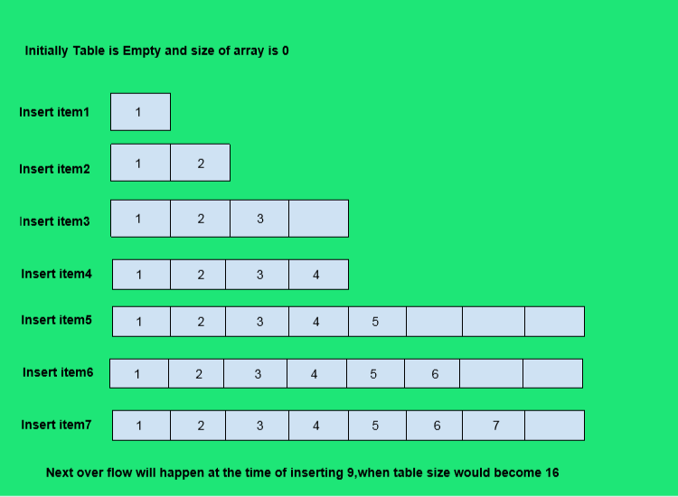
Source=geeks for geeks

Slide 4
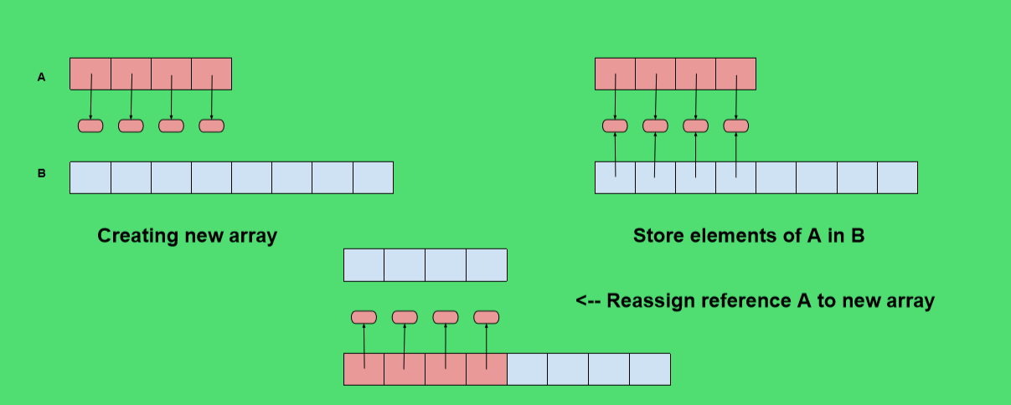
Source=geeks for geeks

Slide 5
Function of Resizable arrays
The main function that are use in our project are…
Append()
Delete()
Resize()
Get()

Slide 6
PSEUDO CODE
resize()
b ← new array(max(1, 2 · n)) b[0, 1, . . . , n − 1] ← a[0, 1, . . . , n − 1]
a ← b
initialize()
a ← new array(1)
n ← 0
append(i, x)
if n = length(a) then resize()
a[i + 1, i + 2, . . . , n] ← a[i, i + 1, . . . , n − 1]
a[i] ← x
n ← n + 1
delete(i)
x ← a[i]
a[i, i + 1, . . . , n − 2] ← a[i + 1, i + 2, . . . , n − 1]
n ← n − 1
if length(a) ≥ 3 · n then resize()
return x
get(i)
return a[i]

Slide 7
